Slide 1
Applications of Information and Communication Technologies
Rabail Asghar
Lecturer (Computer Science)
COMSATS University Islamabad, Lahore Campus

Slide 2
Topics to cover
What is program, programming language?
Programming fundamental concepts:
variables
Variable naming rules
Multiple Assignment
Deleting variables
Python Variable Types-local and global
Datatypes

Slide 3
What is a program?
Program?
A sequence of instructions computer follow to do our task.
Programming?
The process of writing programs is called programming.
Programming language?
A special language that we use to write instructions for a computer to follow.

Slide 4
Programming language?
When we want a computer to perform a specific task, such as adding two numbers, we write these instructions in a programming language.
The computer then reads these instructions and follows them step by step to complete the task.

Slide 5
Programming language?
There are many different programming languages, each with its own set of rules and uses. Some popular examples include Python, Java, and C++.

Slide 6
What is Python?
Definition: Python is a high-level, interpreted programming language created by Guido van Rossum and first released in 1991.
It emphasizes readability and simplicity, making it a great choice for beginners.
Why Python?
Simple Syntax: The syntax is easy to learn and is closer to human language.
Interpreted Language: Python code is executed line by line, which makes debugging easier.
Large Community: Python has a massive community, with plenty of libraries, frameworks, and tutorials.
Cross-Platform: Python is cross-platform, meaning you can run it on Windows, macOS, and Linux.

Slide 7
Python’s Applications
Web Development: Python is widely used for backend web development (using frameworks like Django and Flask).
Data Science and Machine Learning: Python is the go-to language for data analysis, machine learning, and AI with libraries like Pandas, NumPy, and TensorFlow.
Automation and Scripting: Python is commonly used for automating tasks such as data scraping, file manipulation, etc.
Game Development: Python can be used for game development using libraries like Pygame.

Slide 8
Installing python, pycharm
Install PyCharm Community Edition from
https://www.jetbrains.com/pycharm/download/?section=windows

Slide 9

First Program in Python
A simple Python program.
Explanation: print() is a built-in function in Python used to display output to the screen.

Slide 10
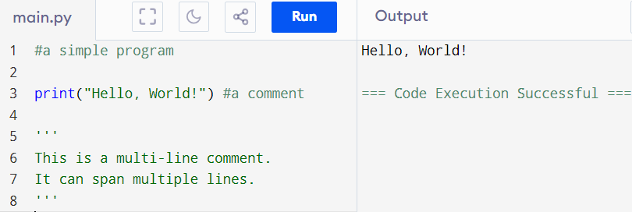
Comments in Python
Single-Line Comments: Begin with # and continue to the end of the line.
Multi-Line Comments: Enclose the comment within triple quotes (''' or """).

Slide 11
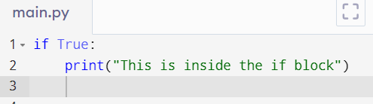
Indentation in Python
Python uses indentation (spaces or tabs) to define the scope of loops, functions, and classes.
Important: Unlike other languages like C++ or Java, Python does not use braces {}. Instead, it uses indentation to determine where a block of code starts and ends

Slide 12
Variables in python

Slide 13
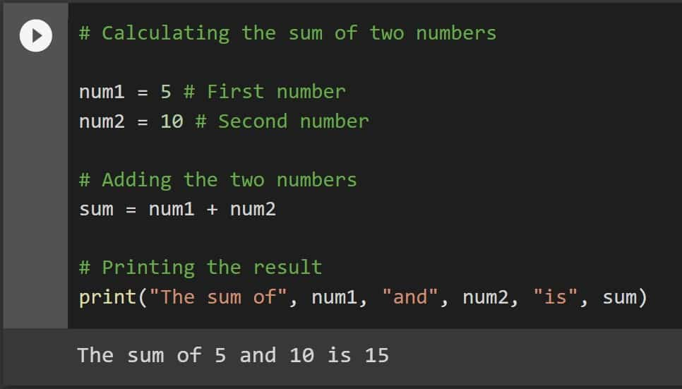
A simple program-

Slide 14
Variables in Python
A variable is like a container that stores data or information.
Imagine you have a labeled box, and you can put anything inside it—this box is your variable.
The name of the Variable is used to refer to the memory location
You can store numbers, words, lists, and other data types in a variable, and then use that variable to perform various operations.

Slide 15
Definition
Variable in Programming is a named storage location that holds a value or data. These values can change during the execution of a program, hence the term “variable.”

Slide 16
Variable naming rules
Python variable names can be group of both of letter and digits.
The first character of variable must be an alphabet or underscore(_)
All the character except the first character may be an alphabet of lower case like(a-z),upper case like(A-Z) and they use the digits(0-9)
Name must not use any white space and special character (!,@,#,%)
Name must not be similar any keyword. E.g print
Identifier name are case sensitive for example :- NAME and name are the different name not a same variable
Example of valid identifier name is :- _name, name1 etc

Slide 17
Creating a Variable in Python
To create a variable in Python, simply choose a name for your variable and assign a value to it using the = sign.
Example:
age = 50
print(age)
This will output: 50
Here, age is the variable name, and 50 is the value stored in it. Whenever you refer to age in your code, Python knows you’re talking about the value 50.

Slide 18
Algorithm vs pseudocode
Aspect | Algorithm | Pseudocode
Definition | A general plan to solve a problem (written in simple sentences). | A detailed, almost-program-like way to describe steps (structured but still not actual code).
Formality | Less formal. High-level. | More structured and closer to real coding style.
Language Style | Natural English sentences. | Uses common programming keywords like INPUT, OUTPUT, CALCULATE.

Slide 19
Example
Algorithm:
Start
Assign two variables with values.
Add two variables into new variable
Finally print the new variable value
End
Pseudocode:
START
SET number1 = 5
SET number2 = 10
CALCULATE sum = number1 + number2
OUTPUT sum
END
CODE
number1 =5
number2=10
sum= number1+ number2
print(sum)

Slide 20
Variables in Python continue..Multiple assignment
Python allows us
to assign a value to multiple variable in a single statement
To Assign multiple values to multiple variables
It is known as Multiple Assignment

Slide 21
Assigning single value to multiple variables
Example:-
a=b=c=100
print(a)
print(b)
print(c)
Or
print(a,b,c)
User assign the multiple variable and assign the single value to multiple variable
Like a and b and c variables value is 100
And next step is print the all values
Notes:
Output
100
100
100

Slide 22
Assigning multiple values to multiple variables
Example:-
a,b,c=10,20,30
print(a)
print(b)
print(c)
User assign the multiple variable and assign the multiple value
And second step print the all values
Notes:
Output
100
100
100

Slide 23
Deleting variables
We can delete the variable use Del keyword
syntax:-
del<variable_name>
Example :-
x=5
print(x)
del x
print(x)
Notes:
5
ERROR!
Traceback (most recent call last):
File "<main.py>", line 4, in <module>
NameError: name 'x' is not defined

Slide 24
Python data types
Variable can hold value and every value has a data type
We do not need to define the type of the variable while declaring or initializing like In other languages
Example:- a=5
The variable ‘a’ hold the integer value five
Python interpreter will automatically depict Data Type of given variable

Slide 25
Data types
Data Type | Description | Example | Typical Byte Size
Integer (int) | Whole numbers without decimals | 150 | 4 bytes
Float (float) | Decimal numbers | 99.99 | 8 bytes
String (str) | Sequence of characters (text) | "John Doe" | 1 byte per character
Boolean (bool) | True/False values | True | 1 byte
List (list) | Collection of items of different types | [200, 300, ‘abc’] | Varies by elements

Slide 26
Python data types
Python provide the type () function to check the data type of any variable
EXAMPLE OF CHECK THE DIFFERENT DATA TYPES:-
a=10
b=“Hi python”
c=10.5
print(type(a))
print(type(b))
print(type(c))
Notes:
<class 'int’>
<class 'str’>
<class 'float'>

Slide 27
Python data types
Checking the data type of a variable is important in programming because it helps ensure that the operations you perform on the variables are appropriate for their types. Different data types support different kinds of operations, and knowing the type of a variable can prevent errors and unintended behavior.

Slide 28
Type Conversion in Python
changing one type of data into another type.
Example:
Turning a number into a string.
Turning a string into a number.

Slide 29
Two Types of Type Conversion:
Type | Meaning | Example
1. Implicit Conversion | Python automatically changes the type. | Adding an integer and a float → result becomes float.
2. Explicit Conversion (Type Casting) | We manually change the type using functions. | Using int(), float(), str(), etc.

Slide 30
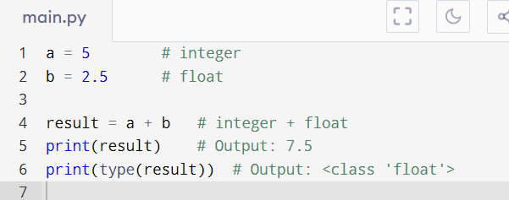
Implicit Type Conversion (Automatic)
Here, Python automatically converted 5 (int) to 5.0 (float) to do the addition.

Slide 31
Explicit Type Conversion (Manual / Type Casting)
We tell Python to change the type by using special functions.
Common functions:
Function | Converts to
int(x) | Integer
float(x) | Float
str(x) | String
bool(x) | Boolean (True/False)

Slide 32
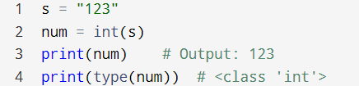
Examples of Explicit Conversion:
String to Integer
Question: Can all strings be converted to numbers?

Slide 33
Practice Questions
Perform following conversions in python and display the result..
Convert "45" (string) into an integer and add 5.
Convert 78.6 (float) into an integer.
Convert 123 (integer) into a string and join it with
" is a number".
Convert 34 (integer) to a float and add 2.5 to it.
Convert 98.7 value into a boolean
In Python, "empty" means False, "non-empty" means True.

Slide 34
Basic Operations with Data Types
Arithmetic Operations:
Addition (+), Subtraction (-), Multiplication (*), Division (/), Modulus (%), Exponentiation (**).

Slide 35
Basic Operations with Data Types
 | Name | Symbol | Definition
 | Addition | + | Adds two numbers together.
 | Subtraction | - | Subtracts the second number from the first.
 | Multiplication | * | Multiplies two numbers.
 | Division | / | Divides the first number by the second and gives the exact (decimal) result.
 | Modulus | % | Gives the remainder after division.
 | Exponentiation | ** | Raises the first number to the power of the second number.

Slide 36
Practice Questions
Perform following calculations in python and display the result..
Calculate the sum of 12 and 15.
Subtract 8 from 20.
Multiply 7 by 5.
Divide 50 by 8 and show the result.
Find the remainder when 22 is divided by 6.
Find 3 raised to the power 4.
Perform floor division of 17 by 3.

Slide 37
String Datatype
The string can be defined as the sequence of characters
python use single ,double and triple quotes to define a string.

Slide 38
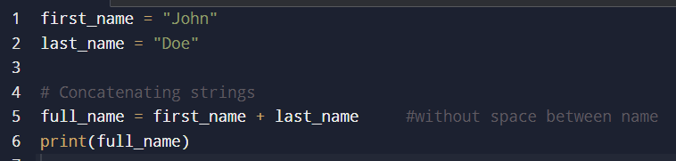
String concatenation
String concatenation is the process of joining two or more strings together to form a single string. In Python, this is typically done using the + operator.
Output:
JohnDoe
Notes:
first_name = "John"
last_name = "Doe"
# Concatenating strings
full_name = first_name + last_name #without space between name
print(full_name)

Slide 39
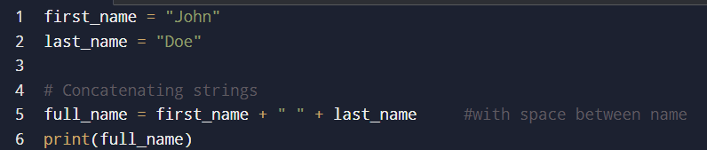
String concatenation
Output:
John Doe
Notes:
first_name = "John"
last_name = "Doe"
# Concatenating strings
full_name = first_name + " " + last_name #with space between name
print(full_name)

Slide 40
Note:
In Python, you can only concatenate strings with strings.
If you want to combine a string with a number, you must convert the number to a string using str().
Question: Is it always true?
Try and find out..

Slide 41
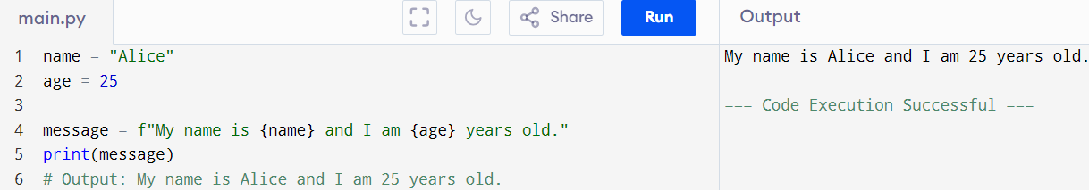
Formatted Strings (f-strings) in Python
With formatted strings, also known as f-strings, you can combine strings and numbers without using str() manually.

Slide 42
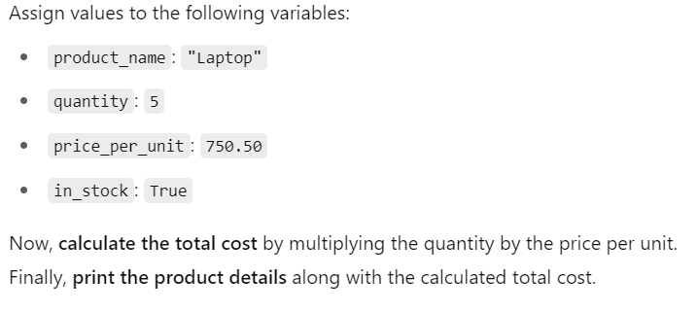
Practice

